Slide 1
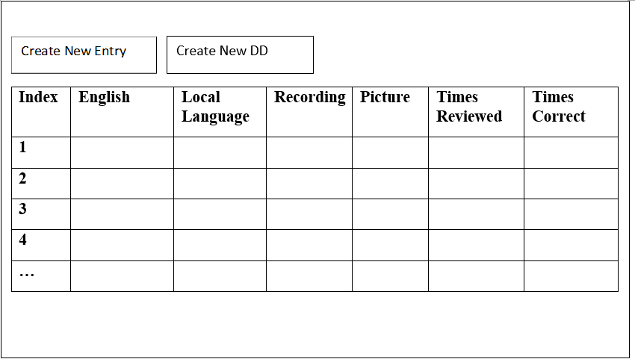
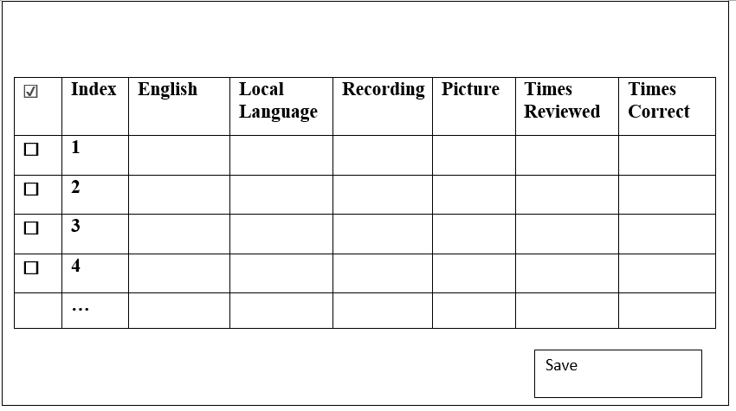
Highlights most recently added card,
Plays associated sound (3) time
Shuffles positions of all cards on screen
Create Card
Shuffle Cards
Introduce
(+)
Shows another card on screen
(-)
Shows one less card on screen
(#/#)
(Number of cards shown /
Total number of cards)
PD
Shows all cards on screen
New Session
Dialogue Box that can browse DD setups
Load
Repeat
Reveal
Save
Load
Clear
Home
Dictionary
Replays Sound
Clears Screen
Highlights ‘correct’ card
Settings
English:_______________________
Save Name:________________________________
Local Language:_______________________
🎤
▶
The purpose of this dialogue is to save what flashcards are in sets together. This should save the name as well as which flashcards are selected. This is saved to the database
Record sound
Play recorded sound
Picture
Allow Pasting of pictures here
Clear Picture
Save
Remove current picture to allow new picture to be pasted
Save word to database
(#) Number of times a card is played when introduced.
☐ Play associated sound again after correct choice?
(Picture/Local language) Show the Picture or Local Language?
(Nothing/English/Local Language) Reveal the English or Local Language on Screen?
(Random/Modified Random) Random will play cards in random order. Modified Random play new cards more often

Slide 2
Database table Design
Index | Unique ID | English | Local Language | Recording File location | Picture File location | Notes | Times Reviewed | Times Correct
1 | 952
2 | 953
3 | 954
4
…
Index | User Created Name | Unique ID Numbers of Flashcards in this set
1 | Parts of Bicycle | 952, 953, 954…
2
3
…

Slide 3

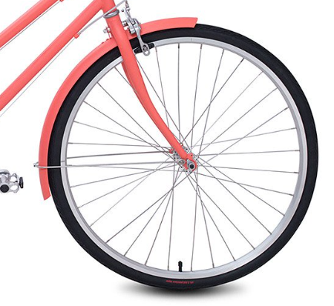


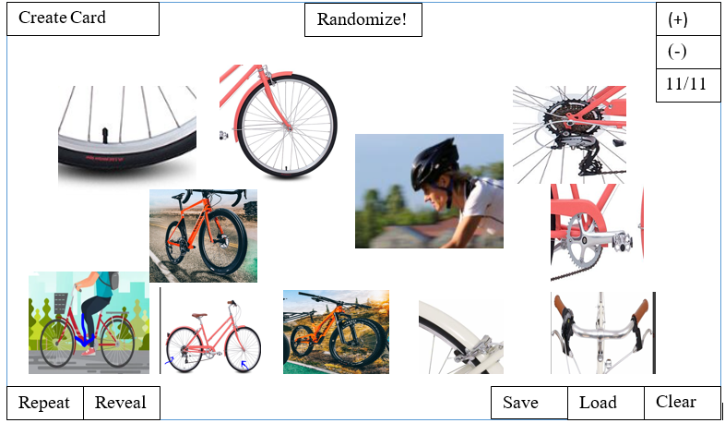

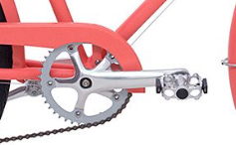
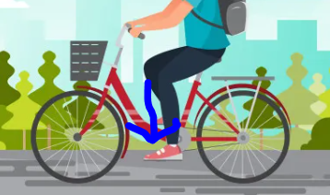
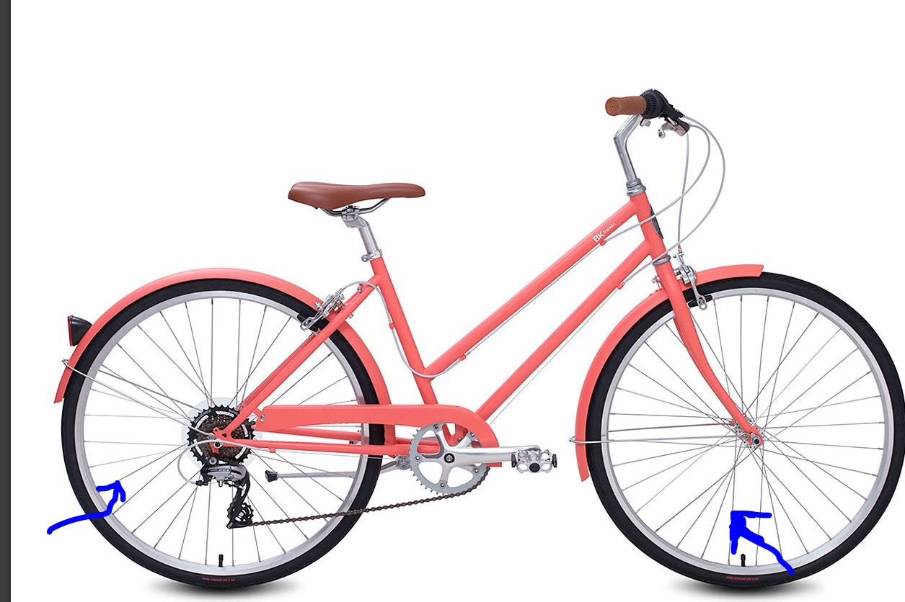



3a) Picture is highlighted if correct. Then, back to (1) App plays sound from randomly selected flashcard
User Interaction with Flashcards
Create Card
Randomize!
(+)
(-)
2) User clicks a picture
11/11
1) App plays sound from randomly selected flashcard
Repeat
Reveal
Save
Load
Clear
3b) Picture is highlighted if not correct. Sound repeats
Create Card
Randomize!
(+)
(-)
11/11
Repeat
Reveal
Save
Load
Clear

Slide 4
User Interaction with (Shuffle Cards / Randomize) button
1) App plays sound from randomly selected flashcard
2) User clicks Shuffle / Randomize
3) The Cards switch positions, the app again plays sound from randomly selected flashcard
Create Card
Randomize!
(+)
(-)
11/11
Repeat
Reveal
Save
Load
Clear

Slide 5
User Interaction with +,- button
1) App plays sound from randomly selected flashcard
2) User clicks +
3) Another Card is added to Screen, App plays sound from randomly most recently added card
Create Card
Randomize!
(+)
Create Card
Randomize!
(+)
Create Card
Randomize!
(+)
(-)
(-)
(-)
2/11
2/11
3/11
Repeat
Reveal
Save
Load
Clear
Repeat
Reveal
Save
Load
Clear
Repeat
Reveal
Save
Load
Clear
1) App plays sound from randomly selected flashcard
2) User clicks -
3) Last added card is removed from screen, App plays sound from randomly selected flashcard
Create Card
Randomize!
(+)
Create Card
Randomize!
(+)
Create Card
Randomize!
(+)
(-)
(-)
(-)
2/11
2/11
1/11
Repeat
Reveal
Save
Load
Clear
Repeat
Reveal
Save
Load
Clear
Repeat
Reveal
Save
Load
Clear

Slide 6
User Interaction with Introduce button
1) User has pressed + button, sound from new card has played once
3) The most recently added card is highlighted, sound is played 3 times. Will work even after Randomize is pressed.
2) User clicks Introduce
Introduce
Introduce
Create Card
Randomize!
(+)
(-)
11/11
Repeat
Reveal
Save
Load
Clear

